Slide 1
A Brief analysis of the COVID-19 spread in the United States
Aparajitha Sriram
Monesa Thoguluva Janardhanan
Shriya Sharma

Slide 2
Introduction
Datasets
Experiments
Conclusion

Slide 3
Introduction
The aim of our study is to find the significant attributes which might be related to the spread of Covid – 19.
The Dataset details and the attributes taken are explained in the next slides.
The first step of our study is to find the attributes which are having relation with the cases data.
Next we used ensemble learning and tried to see which model might fit our data.

Slide 4
Dataset Details
Covid – 19 cases spread can depend on the following factors
Population and Cases
4 different set of cases count of Feb 29th, Mar 17th, Mar 31st and April 19th.
Races Information
Different Races in the state as Covid-19 originated in different country
Environmental Factors
Temperature, Pollution and the Employed people
Chronic Disease Information
Older adults and people of any age who have serious underlying medical conditions might be at higher risk for severe illness from COVID-19[1]

Slide 5
Features included in the dataset
Population and Cases Details
Races Information
Environmental Factors
Chronic Disease Information
State
Cases_Feb_29
Cases_Mar_17
Cases_Mar_31
Cases_Apr_19
Population
Density
State_Area
White_Race
Black_Or_African
Other_Race
Asian_Race
Two_Or_More
Native_American
Native_Hawaiian
Employed_People
Mean_Temp_Feb
Mean_Temp_Mar
Mean_Temp_Apr
Median_Age
Air_Pollution
Asthma
Diabetes
Six_Plus_Teeth_Extractions
High_Blood_Pressure
Multiple_Chronic_Condition_Seniors
Heart_Disease
Heart_Attack
Stroke
High_Cholestrol

Slide 6
Linear Regression
P-value in Linear Regression determines which attribute/feature is meaningful and can be kept in the regression model. P-value which is < 0.05 indicate that we can reject the null hypothesis. Null Hypothesis means there is no statistical significance between two variables.
Linear Regression tries to find out relationship between dependent and independent variable. Here the attributes are our independent variable and the cases are our dependent variable. It says about how well the line fits the data.
The first step of Linear Regression is that we found coefficients and p-value and r-squared value to determine the significant attribute from the datasets.

Slide 7
Multiple Linear Regression
Multiple regression is an extension of linear regression. It finds the relationship between multiple independent and dependent variable. It tells us how well the plane/model fits the data.
R-squared is a statistical measure of how close the data are to the fitted regression line.
We used multiple linear regression to calculate the r-squared values for the best attributes that we found in the linear regression model.

Slide 8
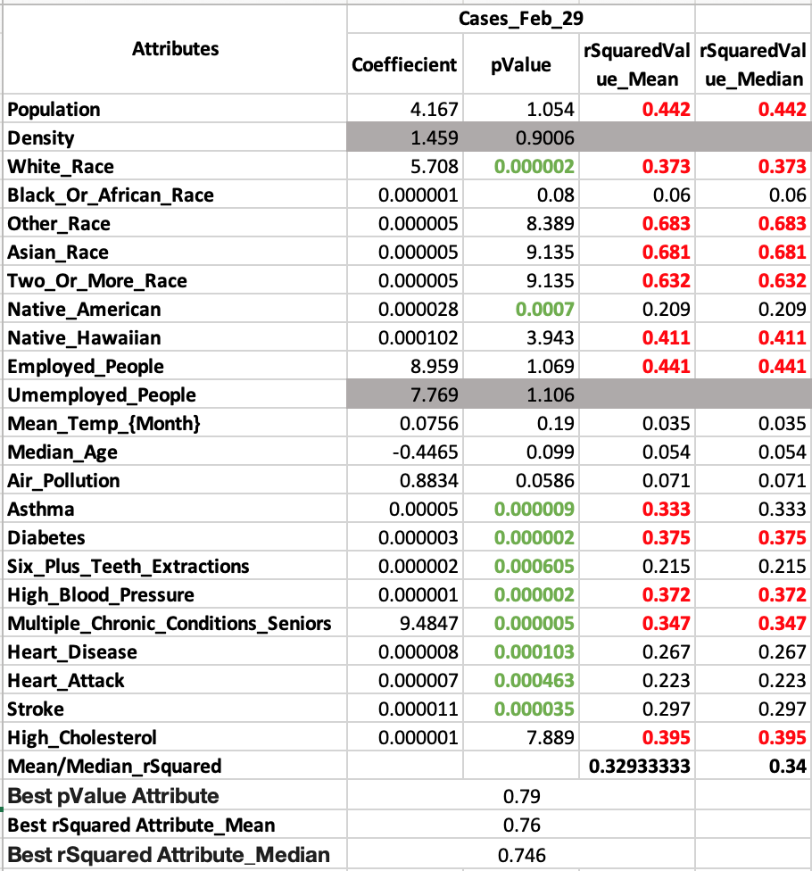
Dataset Analysis till Feb 29
We had few number of cases at the end of Feb 29.
White_Race and Native_Hawaiian are considered to be significant attribute here. So r-Squared value is found for individual attributes.
We could see other_race and Asian_race has higher value of 0.68 compared to other attributes.

Slide 9
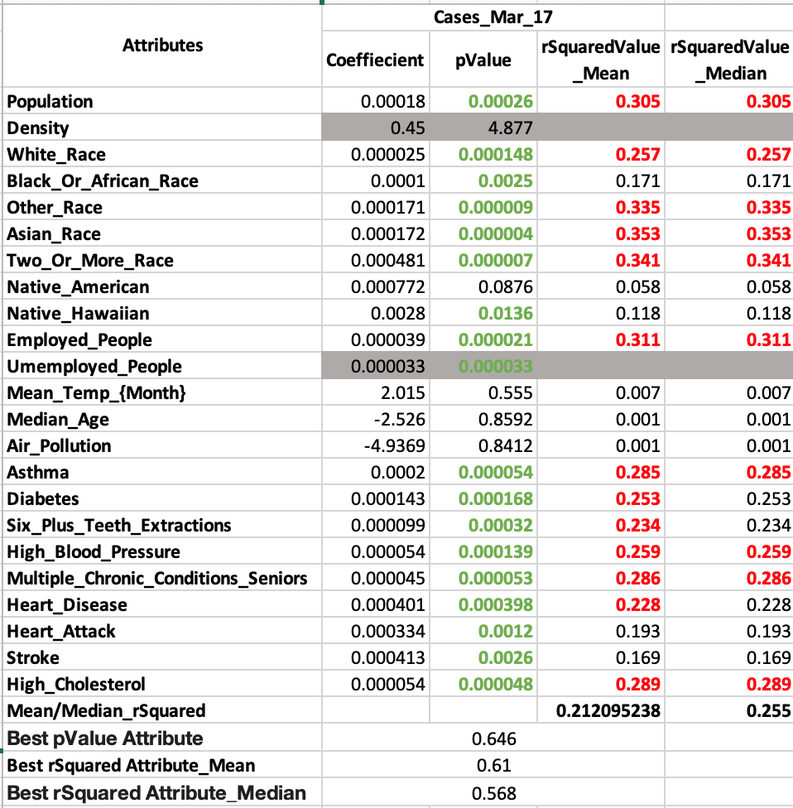
Dataset Analysis till Mar 17
We had taken March 17 because after March 17th we could see exponential increase in the cases.
Attributes related to population and disease are considered to have significant relation to the model in case of p-value
Again Asain Race, Other Race, Two or More Race has high significant percentage of r-squared value compared to other attributes.

Slide 10
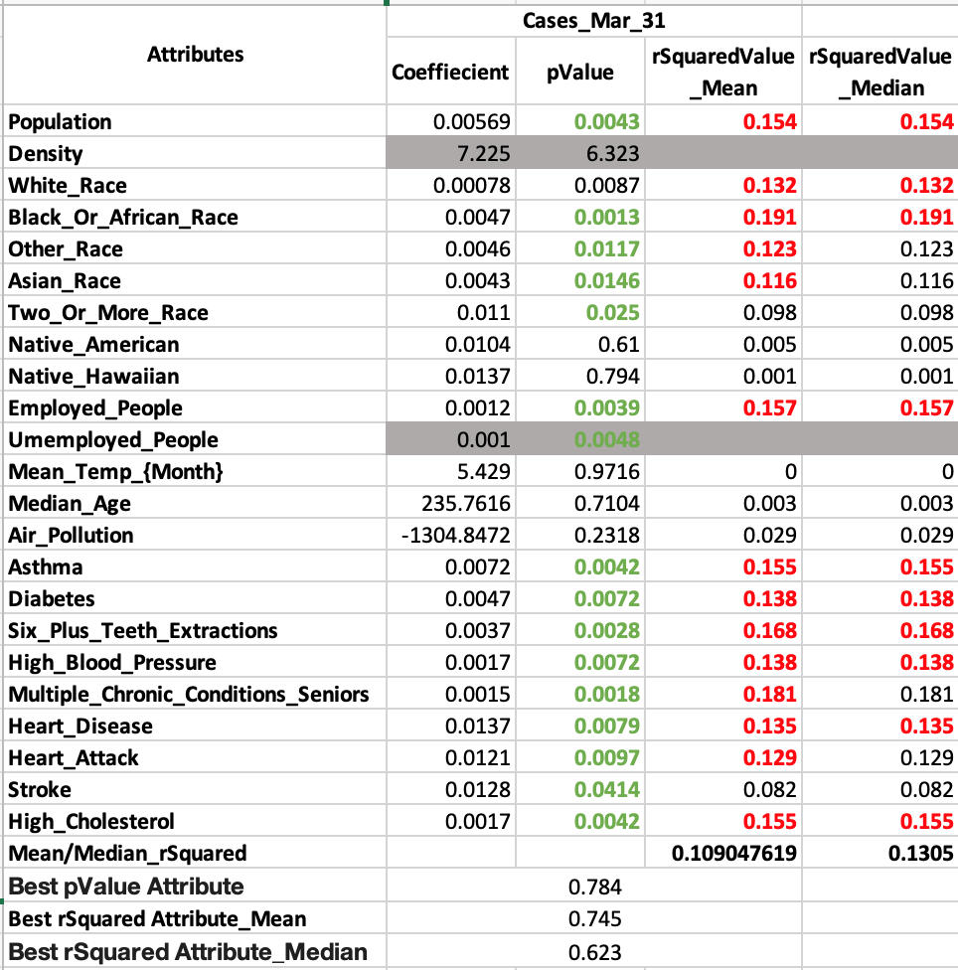
Dataset Analysis till Mar 31
On March 31 we had about 100000 cases which was an exponential increase.
We could see some attributes in the Race gets eliminated as it doesn’t have any significant relation with the cases.
Population, White_Race and Black_Or_African_Race and Employed_People have higher R-Squared value compared to other attributes.

Slide 11
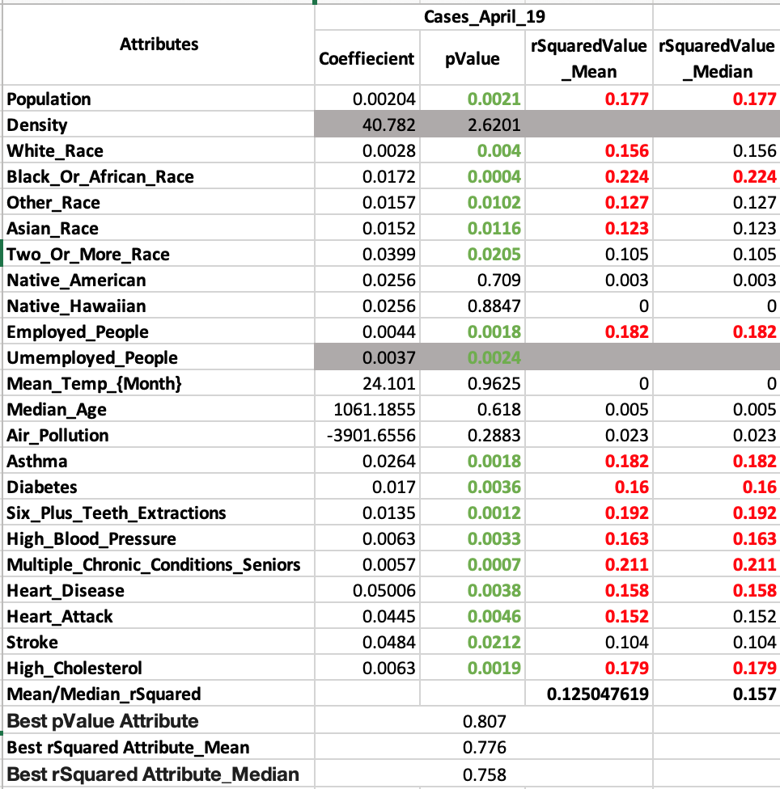
Dataset Analysis till Apr 19
Our dataset is updated till April 19th which was nearly 750000.
Data related to population and chronic diseases are considered to have significant relation with the model.
Population, Black_Or_African_Race, Employed_People and chronic diseases like Asthma, Diabetes, High_Blood_Pressure are having a good r-Squared value.

Slide 12
Regression Analysis
We could find attributes which had significant relation in the start and slowly it got eliminated from the model after the exponential rise.
We could conclude that attributes like Population, Employed_People, People with chronic disease, White Race, Asian Race, Two_Or_More_Race, Black_Or_African_Race are the attributes which are significant to the model.
Air Pollution, Temperature, Age, and chronic disease related to Heart does not have any significant relation to the model.
We are eliminating the attributes which are not significant for the next step of our study.

Slide 13
Next Steps:
The next step in our study is trying to find out which model will suit our data.
This step will have only the best attributes which we have taken from the regression analysis.
We decided to use Ensemble learning for comparing multiple models.
Score is calculated which gives us which model will predict our data best.

Slide 14
Ensemble learning
Ensemble models in machine learning combine the decisions from multiple models to improve the overall performance. These algorithms are divide and conquer approach which is used to improve the overall performance.
These methods are designed to improve the stability and the accuracy of Machine Learning algorithms.
The algorithms used are
1) Decision Tree Regressor
2) Random Forest Regressor
3) Bagging Regressor

Slide 15
Decision Tree Regressor
Decision tree regressor builds regression or classification models in the form of a tree structure. It breaks down a dataset into smaller and smaller subsets while at the same time an associated decision tree is incrementally developed. It observes features of an object and trains a model in the structure of a tree to predict data in the future to produce meaningful continuous
Dataset | Cases predicted with Population | Cases predicted with Asian Race | Cases predicted with White Race | Cases predicted with Black or African Race | Cases predicted with Employed People | Cases predicted with Asthma | Cases predicted with Diabetes | Cases predicted with Six Plus Teeth Extractions | Cases predicted with High Blood Pressure | Cases predicted with Multiple_Chronic_Conditions_Seniors | Cases predicted with High_Cholesterol
Cases_Feb_29 | -0.21 | -0.21 | -1.69 | -0.58 | -0.21 | -1.01 | -0.86 | -0.18 | -1.29 | -0.22 | -0.18
Cases_Mar_17 | -0.55 | -21.15 | -18.17 | -10.63 | -0.27 | -41.99 | -5.44 | -0.25 | -16.03 | -0.92 | -0.87
Cases_Mar_31 | -0.19 | -16.82 | 0.17 | -0.27 | -0.14 | -17.42 | -0.18 | -0.11 | -0.38 | -0.22 | -0.20
Cases_Apr_19 | -0.08 | -7.71 | -0.05 | -0.44 | -0.05 | -8.26 | -0.28 | -0.07 | -0.26 | -0.21 | -0.11

Slide 16
Random Forest Regressor
Random forest adds additional randomness to the model, Instead of searching for the most important feature while splitting a node, it searches for the best feature among a random subset of features. This results in a wide diversity that generally results in a better model. Therefore, in random forest, only a random subset of the features is taken into consideration by the algorithm for splitting a node.
Dataset | Cases predicted with Population | Cases predicted with Asian Race | Cases predicted with White Race | Cases predicted with Black or African Race | Cases predicted with Employed People | Cases predicted with Asthma | Cases predicted with Diabetes | Cases predicted with Six Plus Teeth Extractions | Cases predicted with High Blood Pressure | Cases predicted with Multiple_Chronic_Conditions_Seniors | Cases predicted with High_Cholesterol
Cases_Feb_29 | 0.01 | 0.03 | 0.01 | -0.15 | 0.02 | 0.00 | 0.03 | -0.19 | -0.19 | 0.04 | 0.19
Cases_Mar_17 | -3.57 | -1.01 | -2.57 | -0.65 | -1.21 | -5.43 | -1.25 | -2.63 | 0.14 | -1.31 | -1.77
Cases_Mar_31 | -0.91 | -0.14 | -0.09 | -2.96 | -3.12 | -0.32 | -0.80 | -0.91 | -0.24 | -0.21 | -0.76
Cases_Apr_19 | 0.02 | -0.79 | -1.38 | -0.30 | -0.41 | -1.46 | -2.97 | -0.25 | -0.12 | -0.69 | -0.84

Slide 17
Bagging Regressor
A Bagging regressor is an ensemble meta-estimator that divides the training sample randomly into multiple bags and trains the model for each bag and finds the mean value for the ensemble.
Dataset | Cases predicted with Population | Cases predicted with Asian Race | Cases predicted with White Race | Cases predicted with Black or African Race | Cases predicted with Employed People | Cases predicted with Asthma | Cases predicted with Diabetes | Cases predicted with Six Plus Teeth Extractions | Cases predicted with High Blood Pressure | Cases predicted with Multiple_Chronic_Conditions_Seniors | Cases predicted with High_Cholesterol
Cases_Feb_29 | -4.86 | -0.04 | 0.15 | -0.12 | 0.18 | -0.24 | 0.19 | 0.20 | 0.21 | 0.06 | 0.12
Cases_Mar_17 | 1.39 | -7.86 | -4.05 | -3.38 | -3.83 | -9.80 | -2.77 | -4.88 | -5.59 | -2.34 | -1.84
Cases_Mar_31 | 0.81 | -3.35 | 1.05 | 0.85 | 1.70 | -3.76 | -1.92 | -0.64 | -1.08 | 0.47 | -1.23
Cases_Apr_19 | 0.59 | -0.79 | 0.27 | -0.46 | 0.69 | -1.28 | 0.39 | -0.81 | 0.02 | 0.14 | -0.95

Slide 18
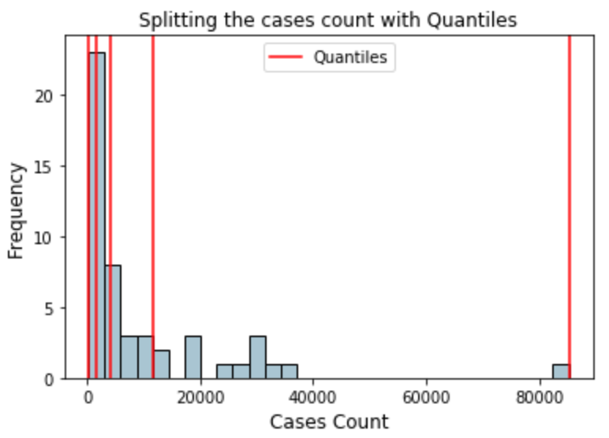
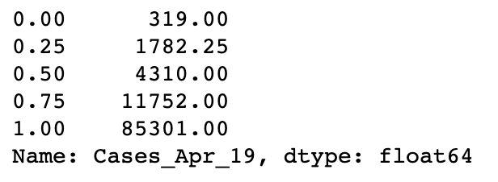
Additional Steps
We split the cases into different quantiles and range is shown as shown in the left image and divided the dataset into 4 different parts.

Slide 19
Conclusion
In this study we used Regression analysis to find out the best attributes that is having significant relationship with the data.
Next, we used ensemble learning to find out which algorithm might be the best fit for our data.
We analyzed the results from which we found that the relationship of the features we chose were not prevalent at all times due to the change in the data at real-time.
However, we were able to draw patterns in the way the relationships of the features changed over time, as COVID-19 spread across the US.
This analysis gave us a basic view of what factors influenced the disease spread at the initial stages in the US and what factors were strong at the later stages.

Slide 20
References
https://www.cdc.gov/coronavirus/2019-ncov/need-extra-precautions/people-at-higher-risk.html
https://dataverse.harvard.edu/dataset.xhtml;jsessionid=d62174402d55b0f954151889237b?persistentId=doi:10.7910/DVN/HIDLTK
https://www.usclimatedata.com/climate/united-states/us
https://www.statista.com/statistics/223669/state-employment-in-the-us/
https://www.americashealthrankings.org/explore/annual/measure/air/state/ALL?edition-year=2019
https://www.americashealthrankings.org/explore/annual/measure/air/state/ALL?edition-year=2019
https://worldpopulationreview.com/states/

